Slide 1
Glucose Disparity Proxy
Identifying disparity proxies in MIMIC-IV
for glucose measurements

Slide 2
Research Question
Do people get their glucose levels monitored equally according to race, English proficiency, and sex?
Does the frequency of glucose measurements vary across above demographics?

Slide 3
Figure 1
All Mimic IV Stay IDs
n = 73,181
Younger than 18
N= 84
N = 73,097
Non-sepsis
N = 40,143
N = 32,954
Los < 1
N = 3,346
N = 29,608
Race: others removed
N = 4,681
N = 24,927
Notes:
Add boxes

Slide 4
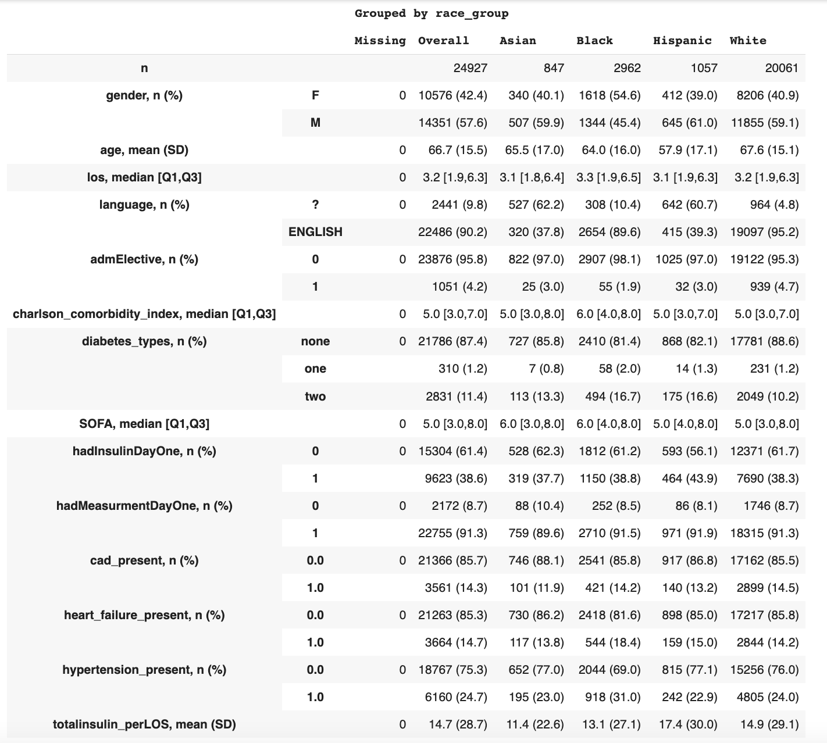
Table 1
Notes:
Delete missing column; make bigger; rename variables such as CCI, adjust and edit our for adm_elective and other binary variables only keep the line with ‘1’

Slide 5
Table 1
Notes:
Delete missing column; make bigger; rename variables such as CCI; report median and IQR for totalinsulin_perLOS

Slide 6
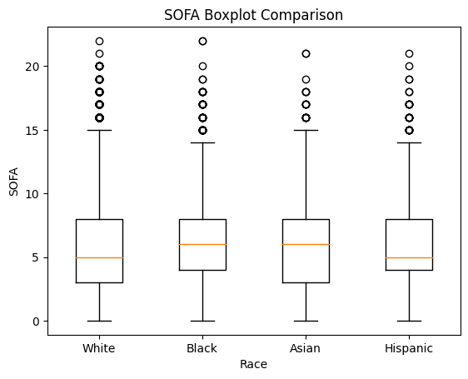
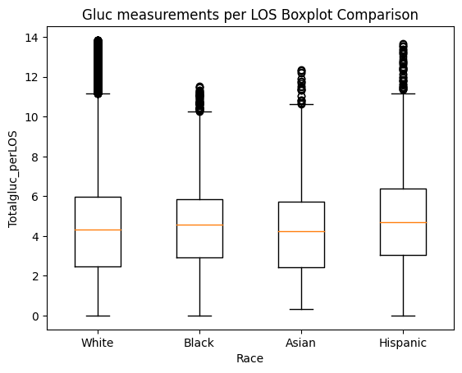
Raw Data Boxplots

Slide 7
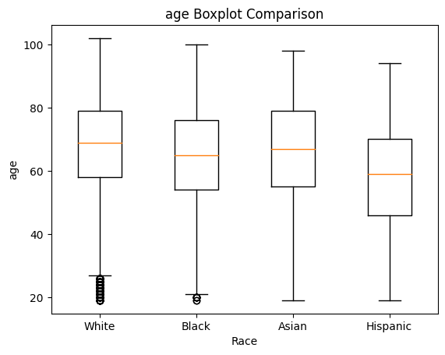
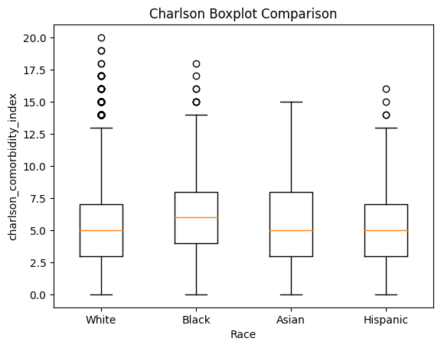
Raw Data Boxplots (Cont’d)

Slide 8
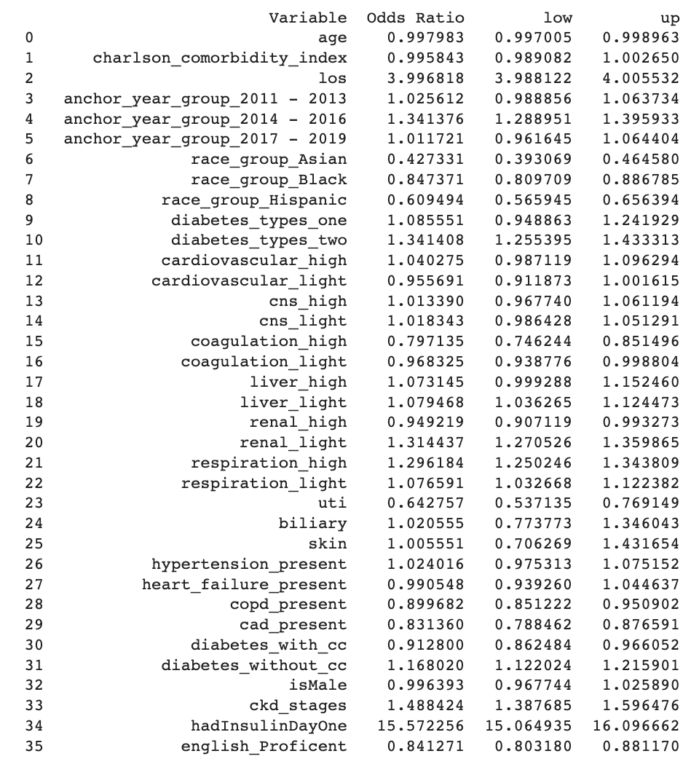
Logistic Regression
Null hypothesis: all patient are equally likely to receive a measurement
Outcome measurement first day yes/no
Include English proficiency, sex, insulin day 1
Notes:
Update with actual table

Slide 9
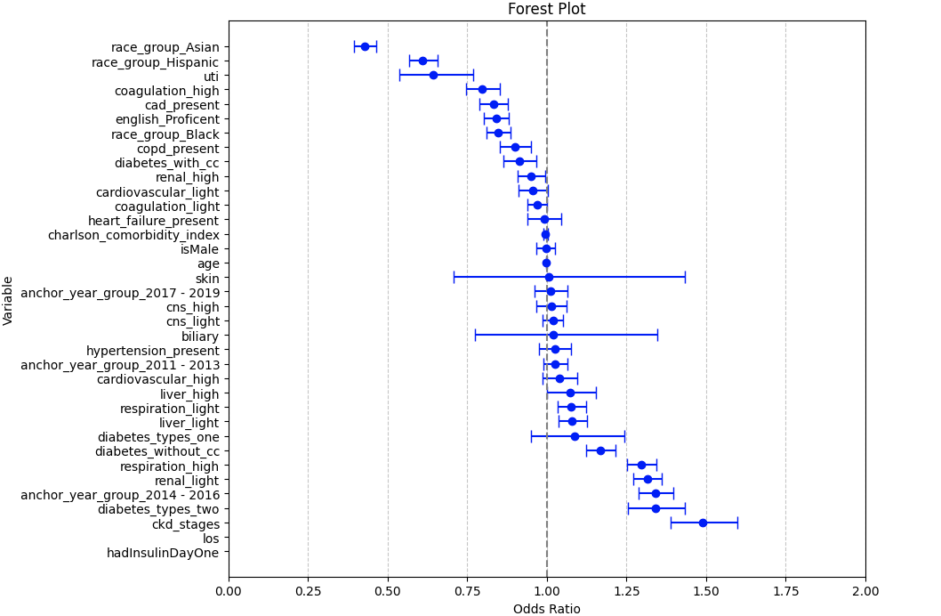

Slide 10
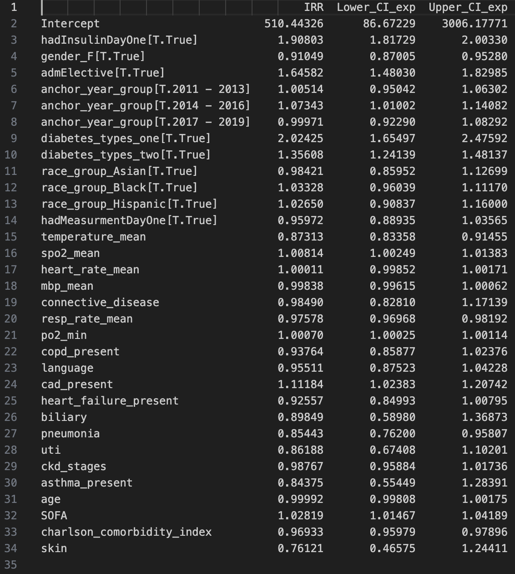
Negative Binomial Model
Null Hypothesis: All patients are equally likely to receive glucose measurements
Outcome Measurement: Total frequency of glucose measurements taken per patient per length of stay
Includes English Proficiency, sex, age, SOFA, and lab values

Slide 11
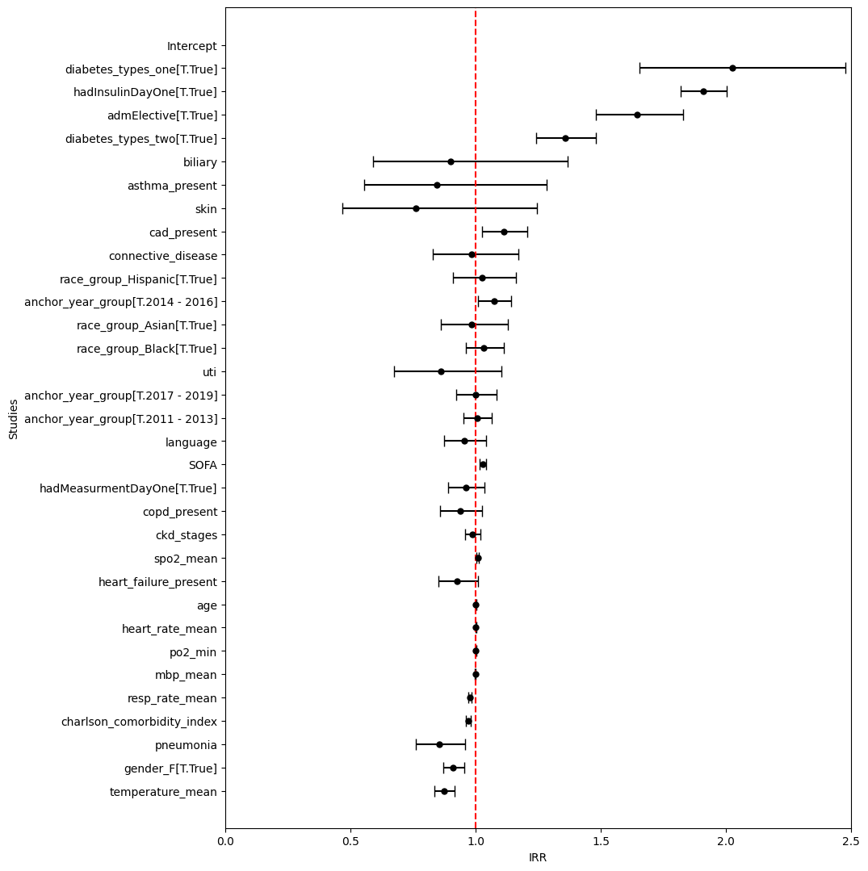
Forest Plot for Negative Binomial Model
Total Frequency of Glucose measurements per patient per length of stay
Notes:
Get rid of intercept

Slide 12
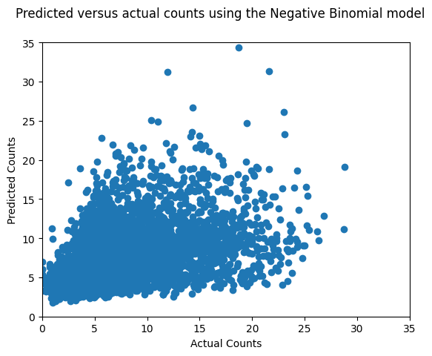
Graphs- Neg. Bin Model
Actual vs predicted for total frequency of glucose measurements per patient per length of stay
RMSE: 3.915177
R^2: 21.18 %

Slide 13
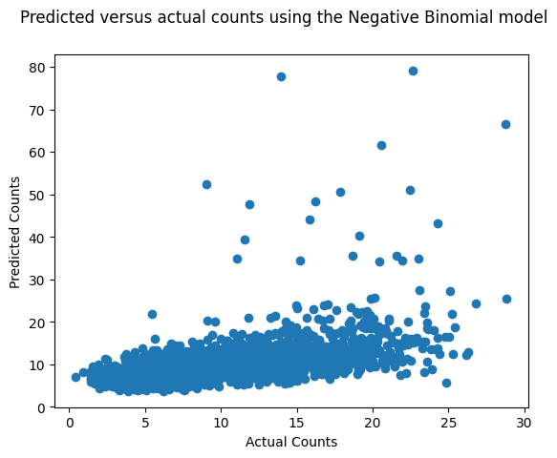
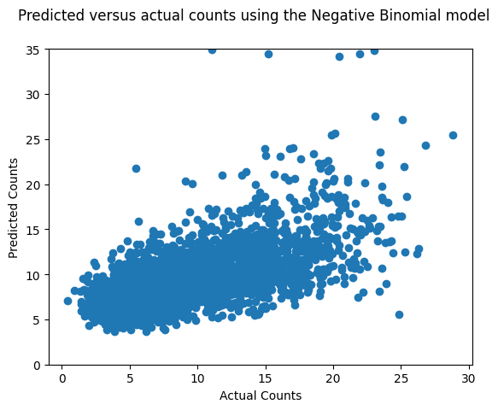
Graphs- Neg. Bin Model
With insulin normalized by patient weight
Increases R^2 and decreases RMSE
Concern: Only uses 56% of data allotted for training
Increases Outliers
Zoomed in for specific range
RMSE: 3.88726
R^2: 23.42 %

Slide 14
Result Summary
Monitoring of Glucose levels
State Results
Frequency of glucose measurements
Frequency remains unimpacted by language and race
Sex: Female is 8% less likely to have same frequency of glucose measurements

